Slide 1


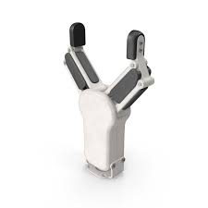


SPC 228 – Fall 2024
Engineering Dynamics
Robot Gripper Mechanism
Group
Abdelrahman Abdelghany – 202301000
Mostafa Elsabagh – 202300781
Martin Rober – 202301070

Slide 2
Abstract
♠ Robot grippers have their fair share of practical use
♠ The ideas presented hinge on the main principles of dynamics

Slide 3
Introduction
♠ Grippers are robotic constructions that mimic a human hand
♠ They are almost indispensable in industries where continuous labor can cause a human to tire or become error-prone

Slide 4
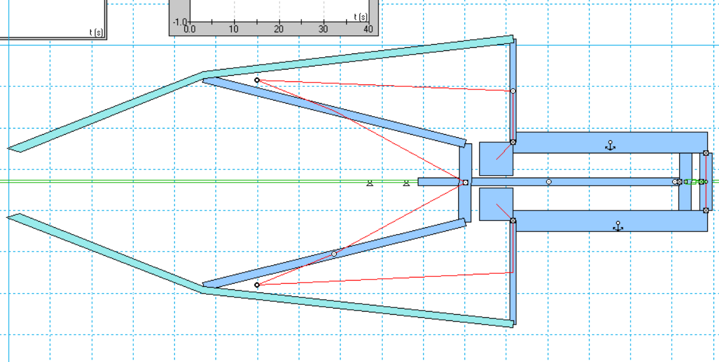
Why use a Gripper?
They are light, work tirelessly, and can do labor work
They are mechanically simple; as such, they are not difficult (or expensive, at that) to construct

Slide 5
Working Principle
♠ The motion of the piston causes a conversion of linear motion into a circular motion of the gripping arms. This is mainly facilitated by the joints present, and the connecting links. Those links rotate, and as such, they open/close the gripper arm as they go along in their predetermined paths. Put simply, the device operates based on the principles of rigid body rotation and translation.

Slide 6
Design consideration
Load Capacity: The loads used have to be considered, in order to determine the operation range of the device
Gripping Force: The force output must be considered
Material compatibility: Some materials offer a good grip surface, while others don’t.
Flexibility and Range of Motion: We take care to ensure a good range of motion.

Slide 7
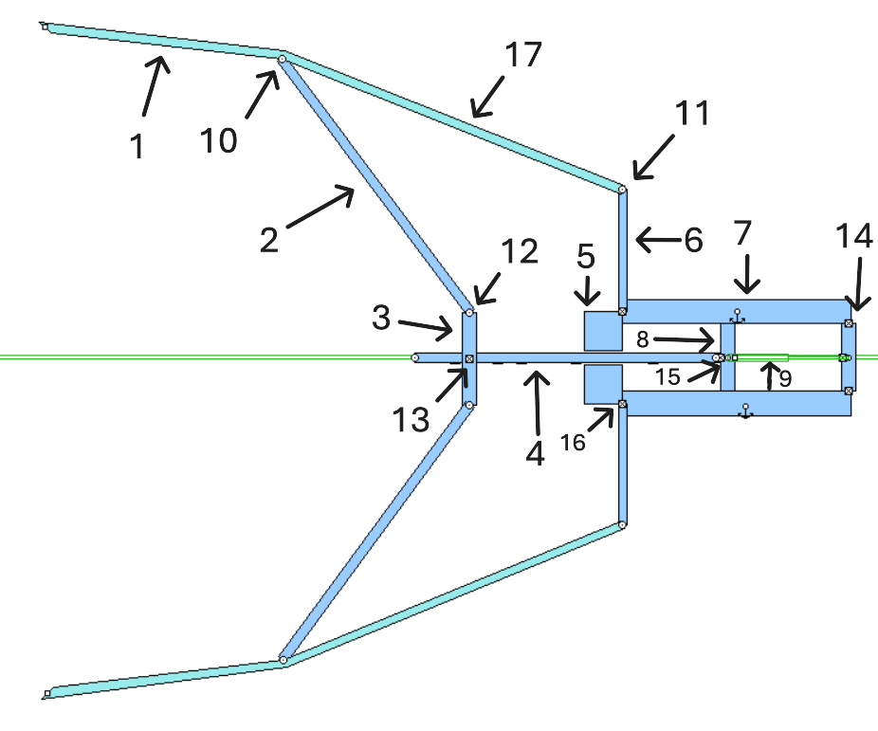
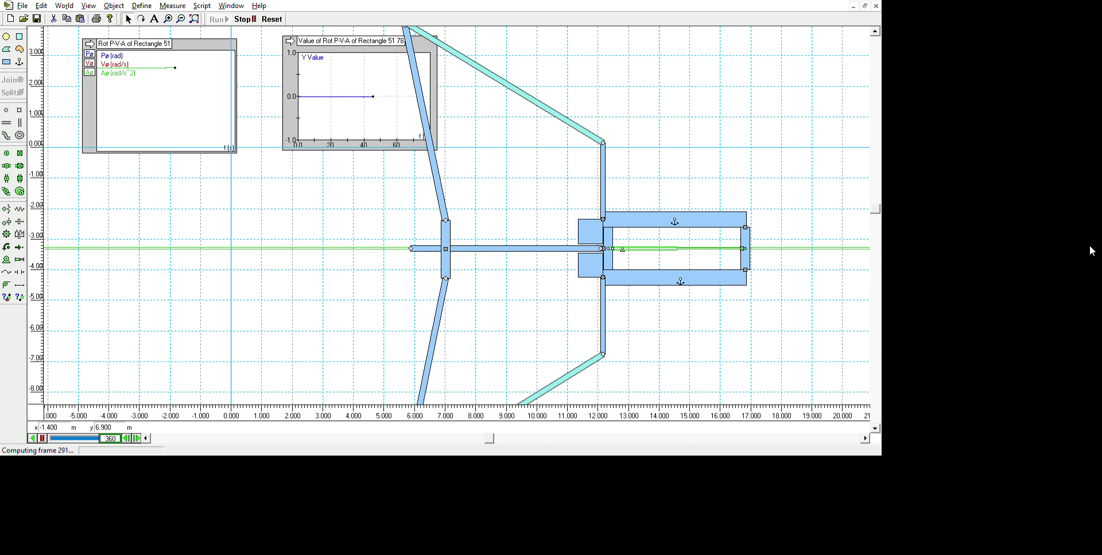
The Design
(Simulated in Working Model 2D)

Slide 8
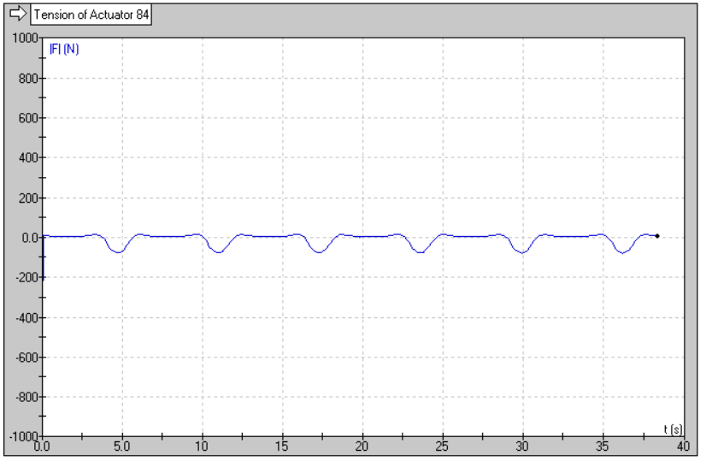
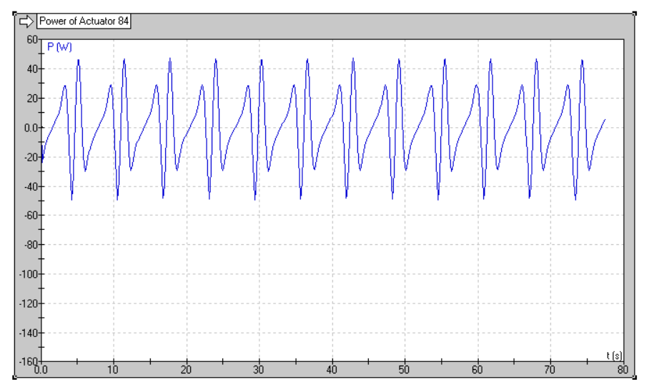
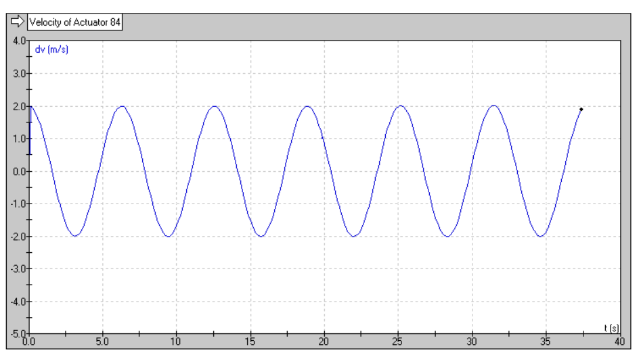
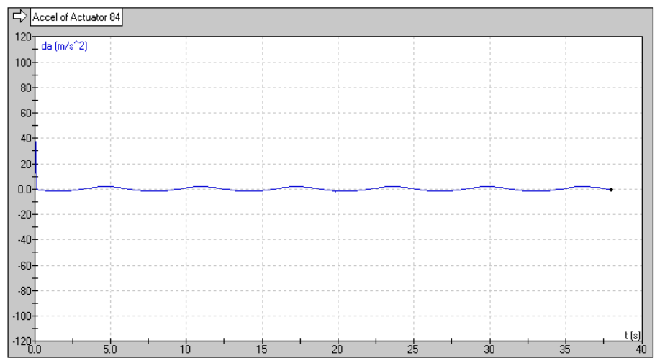
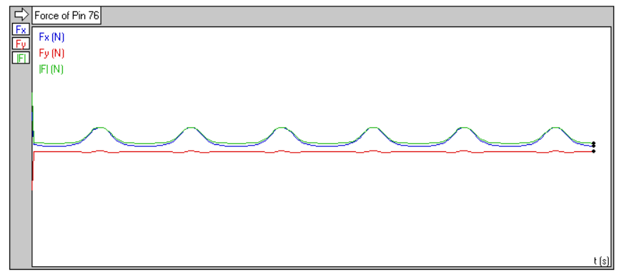
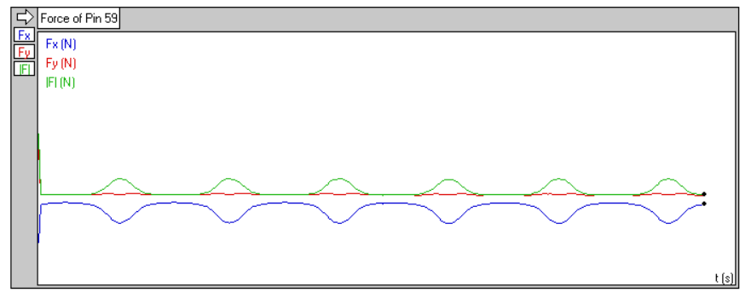
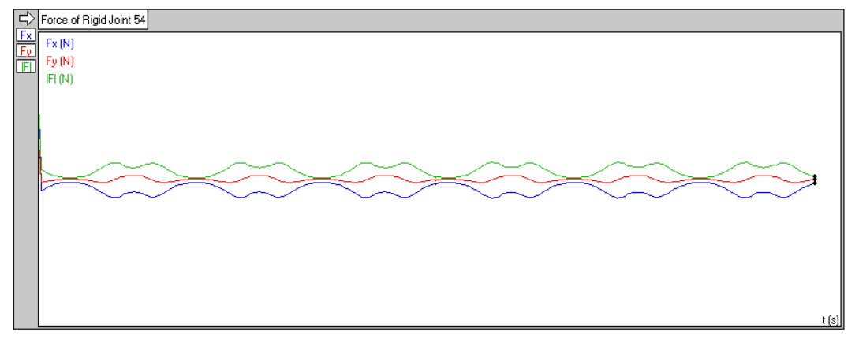
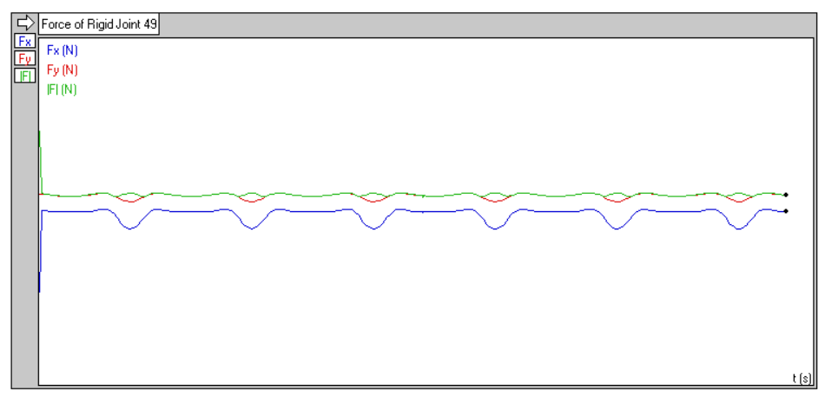
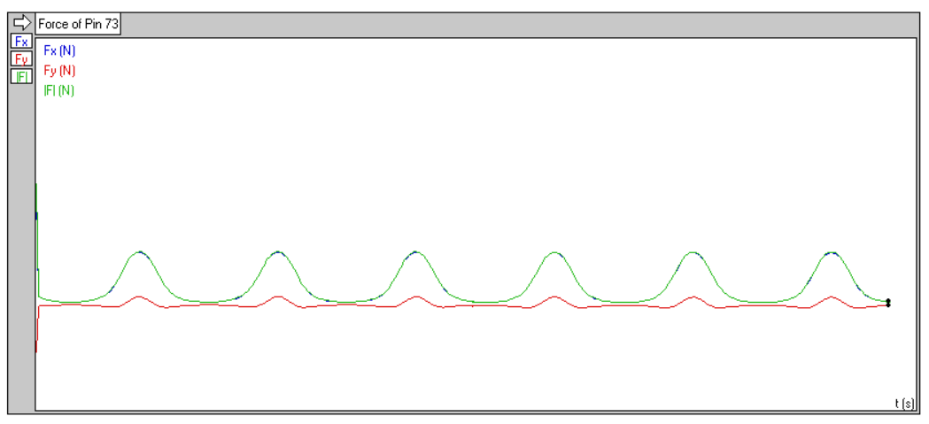
Plots
Actuator tension input power
Actuator Velocity
Actuator Acceleration
Member 10 force
Member 12 force
Member 14 force
Member 13 force
Member 11 force

Slide 9
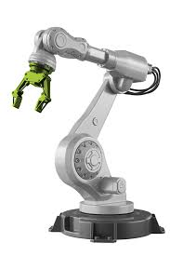
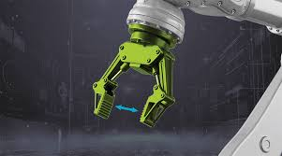
Applications
Manufacturing (e.g: Car Manufacturing)
Healthcare (e.g: Precise Surgical Robots)
Agriculture (e.g: Reaping Machines)
Logistics (e.g: Package Sorting)
Entertainment (e.g: Games in Arcades)

Slide 10
Conclusion
In conclusion, robot grippers are mainly used for their ability to perform routine actions tirelessly, where a human would be more error-prone. For this reason, we’ve designed a robot gripper (albeit small-scale), which performs said menial tasks without any issues.

Slide 11
THANK YOU!!

